Slide 1

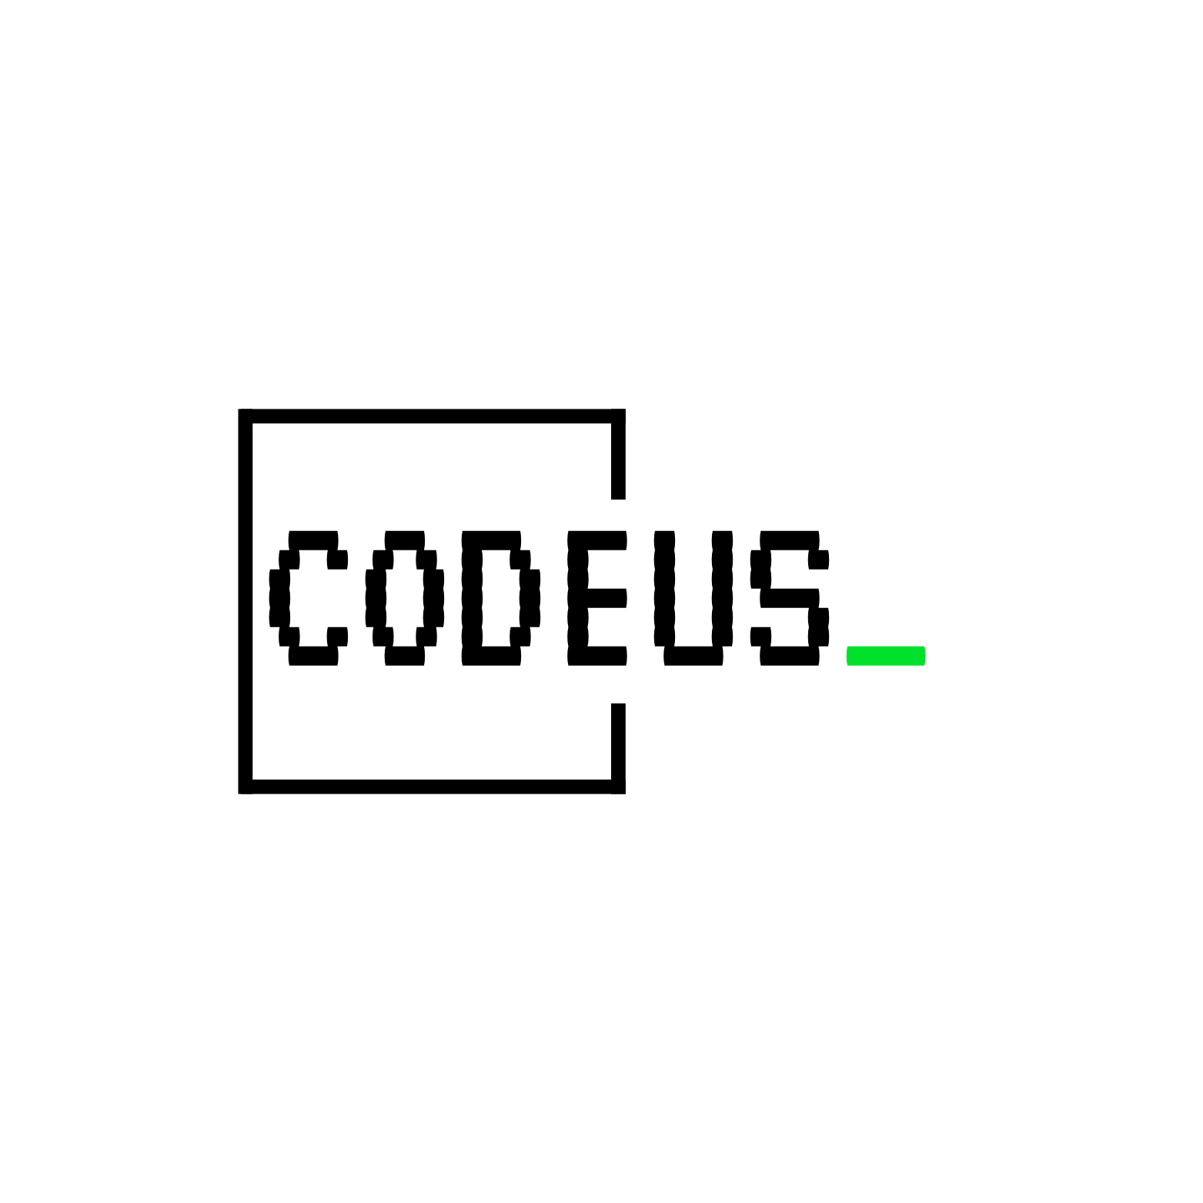
Leaf Transaction

Slide 2

Content
Proxy Pattern recap
How does Spring work?
@Transactional annotation processing
Dynamic-Proxy
Task setup

Slide 3
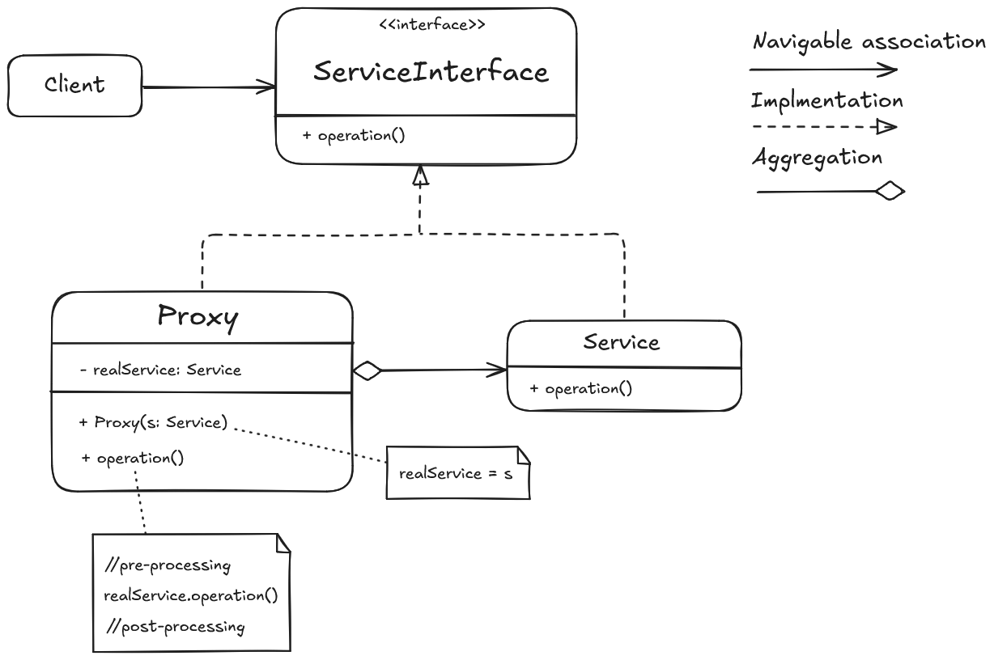
Proxy Pattern

Slide 4
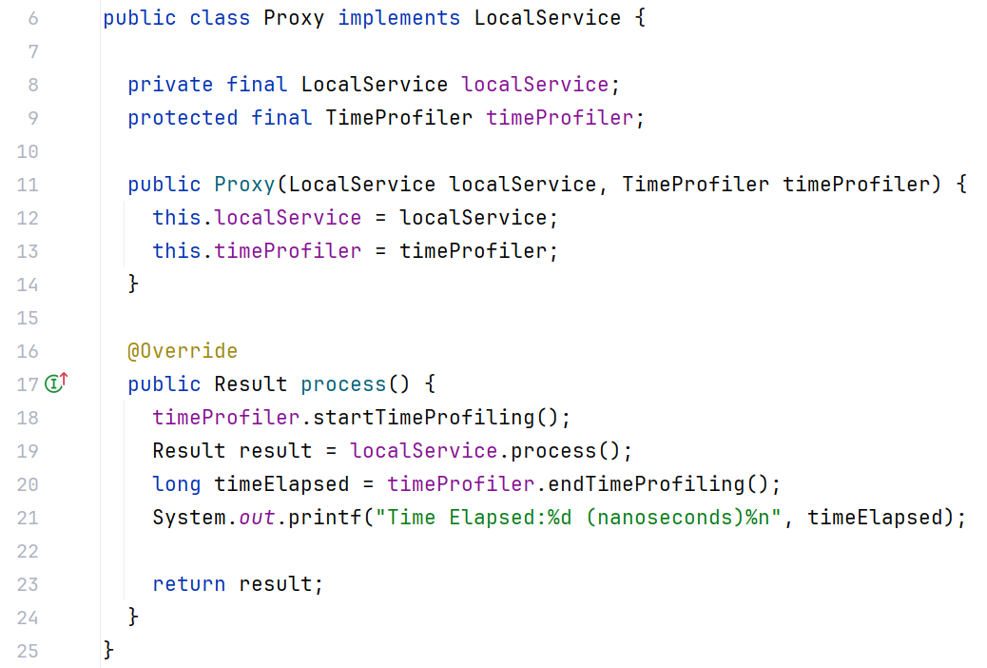
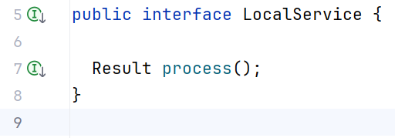
Proxy Pattern: Example

Slide 5
How does Spring work?
Bean Definition Reader(s)
Classes
Bean Factory
Beans
IoC Container
Bean Post Processors
Bean Definitions
Fully configured objects

Slide 6
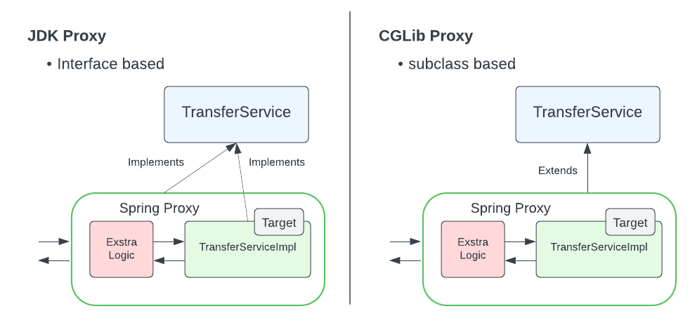
How does Spring work?

Slide 7
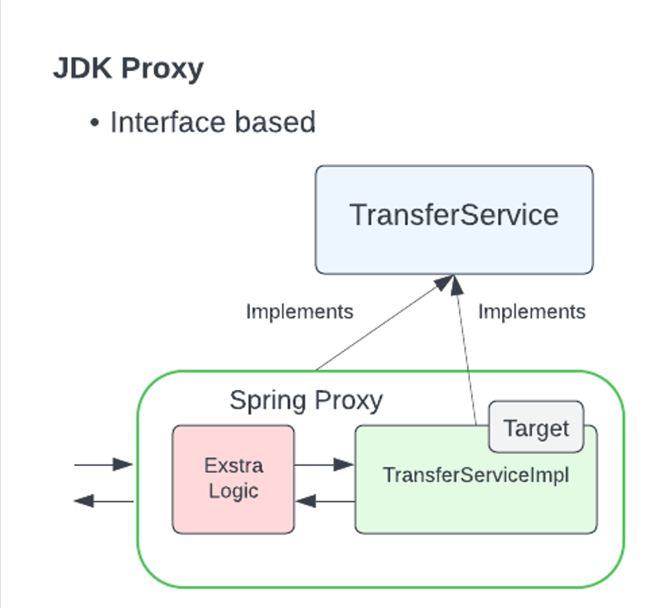
Dynamic-Proxy
JDK Proxy follows the same design as well known Proxy Design Pattern

Slide 8
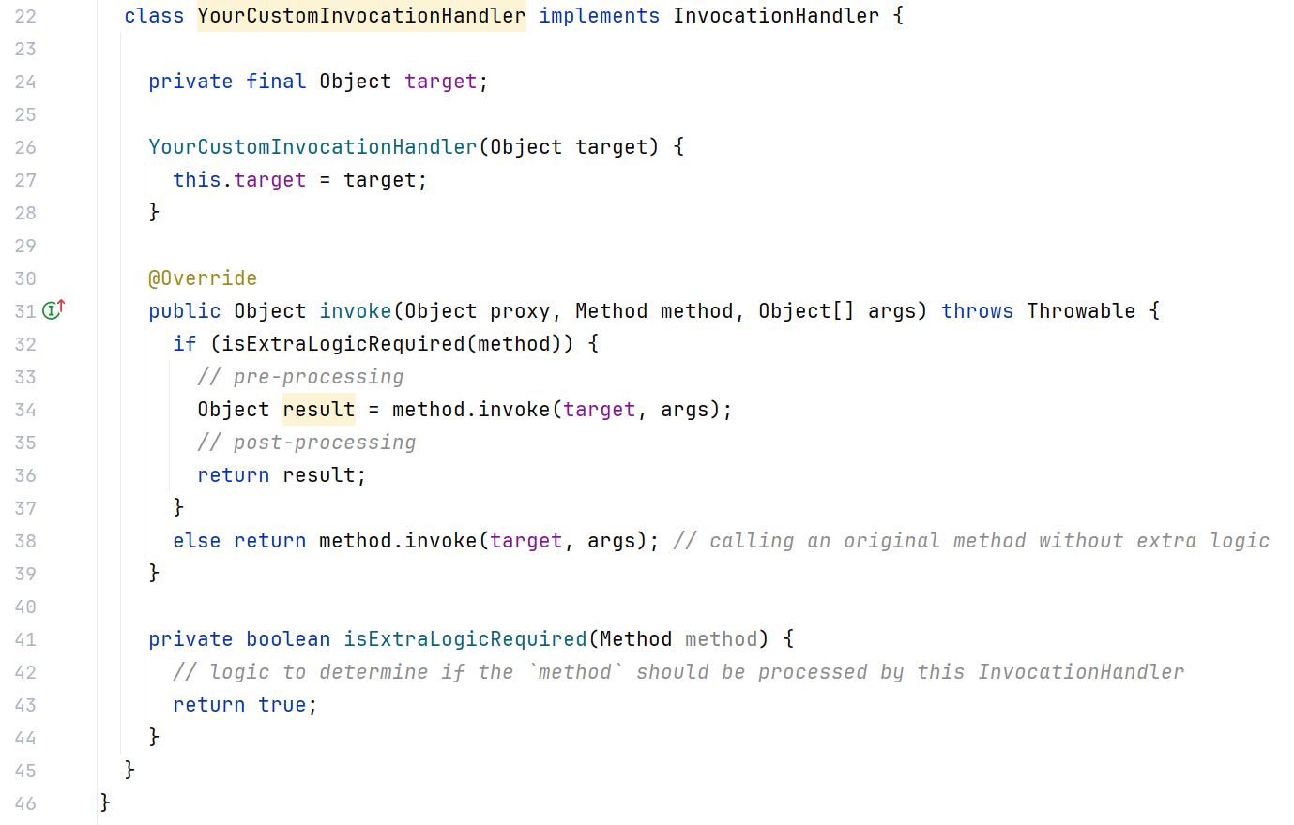
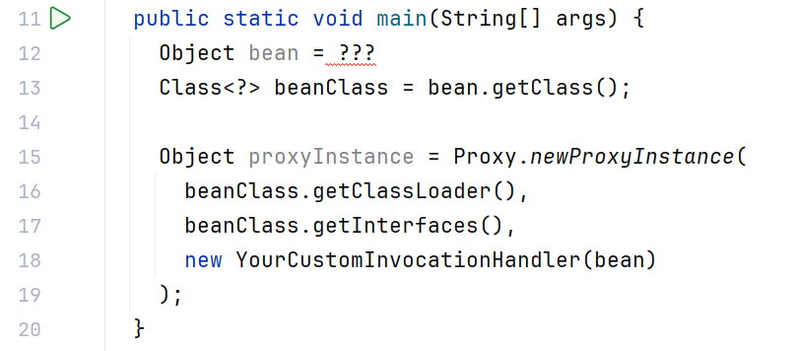
Dynamic-Proxy

Slide 9

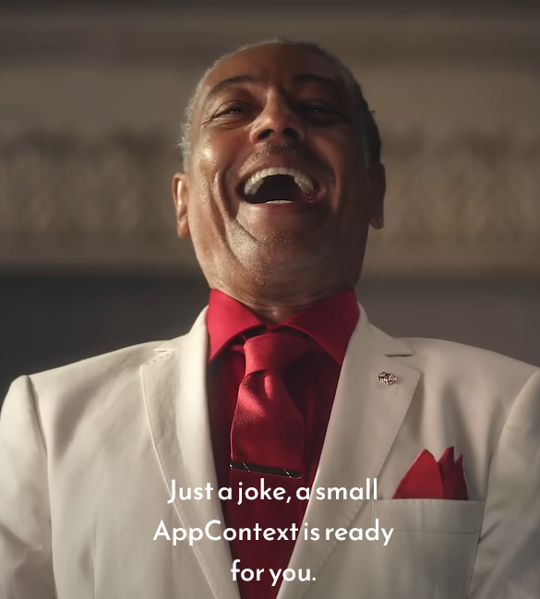
Task Setup: Code base
You will need to create the whole ApplicationContext and then process @Transactional annotation

Slide 10
Task Setup: Code base
Application Context
Full custom code
Creates a limited set of preconfigured beans
Doesn't use Spring's interfaces
Represents only part of the Spring functionality
Classes
Bean Factory
Beans
!No Bean Definition Reader
!No Bean Definitions
!No Bean Post Processors
IoC Container
Fully configured objects

Slide 11
Task Setup: Goal
Replace manual transaction handling in the task code with a Proxy.
There are 3 main steps.

Slide 12
Task Setup: Goal
Step 1
Create @Transactional annotation.

Slide 13
Task Setup: Goal
Create @Transactional annotation.
Step 1
Step 2
Create Proxy wrapper

Slide 14
Task Setup: Goal
Create @Transactional annotation.
Create Proxy wrapper
Step 1
Step 2
Step 2
Step 3
Implement Proxy wrapping logic for objects that have methods annotated with @Transactional

Slide 15
Task Setup: Goal
Create @Transactional annotation.
Create Proxy wrapper
Implement Proxy wrapping logic for objects that have methods annotated with @Transactional
Step 1
Step 2
Step 2
Step 3
Step 3
Step 4
Test your solution (Bonus)

Slide 16
Task Setup: Goal
Create @Transactional annotation.
Create Proxy wrapper
Implement Proxy wrapping logic for objects that have methods annotated with @Transactional
Test your solution
Step 1
Step 2
Step 2
Step 3
Step 3
Step 4

Slide 17
Task Setup: Flow
You will be working in pair using pair programming technique.
Driver
writes code
follows Navigator instructions and feedback
"tactical" direction of the work
Navigator
doesn't write code
gives instructions and feedback to Driver
"strategic" direction of the work

Slide 18

Thank you
Author: Serhii Kravchuk
My LinkedIn
Date: 13 December 2024
Join Codeus community in Discord
Join Codeus community in LinkedIn

